Slide 1
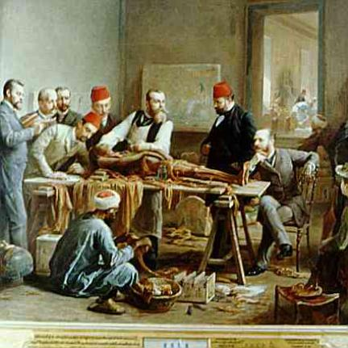
Guided Notes for these slides can be printed.
Introduction to Human Anatomy and Physiology
(Chapter 1)
Notes:
To edit slides, download a copy to your own drive or choose to “make a copy” from the file menu. https://openstax.org/books/anatomy-and-physiology/pages/1-2-structural-organization-of-the-human-body Looking for the old version that aligns with Hole’s anatomy: click on https://docs.google.com/presentation/d/1vGjjCCgMnXxN_NjOSTv8P7bcpcnF_CEq9ovfakTg978/edit?usp=sharing

Slide 2
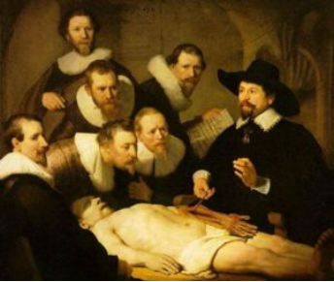
Anatomy – the structure of body parts (also called morphology)
Physiology – the function of the body parts
Historically, the study of anatomy has been difficult because of restrictions and laws regarding human dissection.
Later, when restrictions were lifted, the demand for bodies lead to body snatching, people who dug up graves to sell them were called “resurrectionists.”
Check out the story of Burke and Hare, famous serial killers who killed people to sell their bodies. (6 min video)

Slide 3
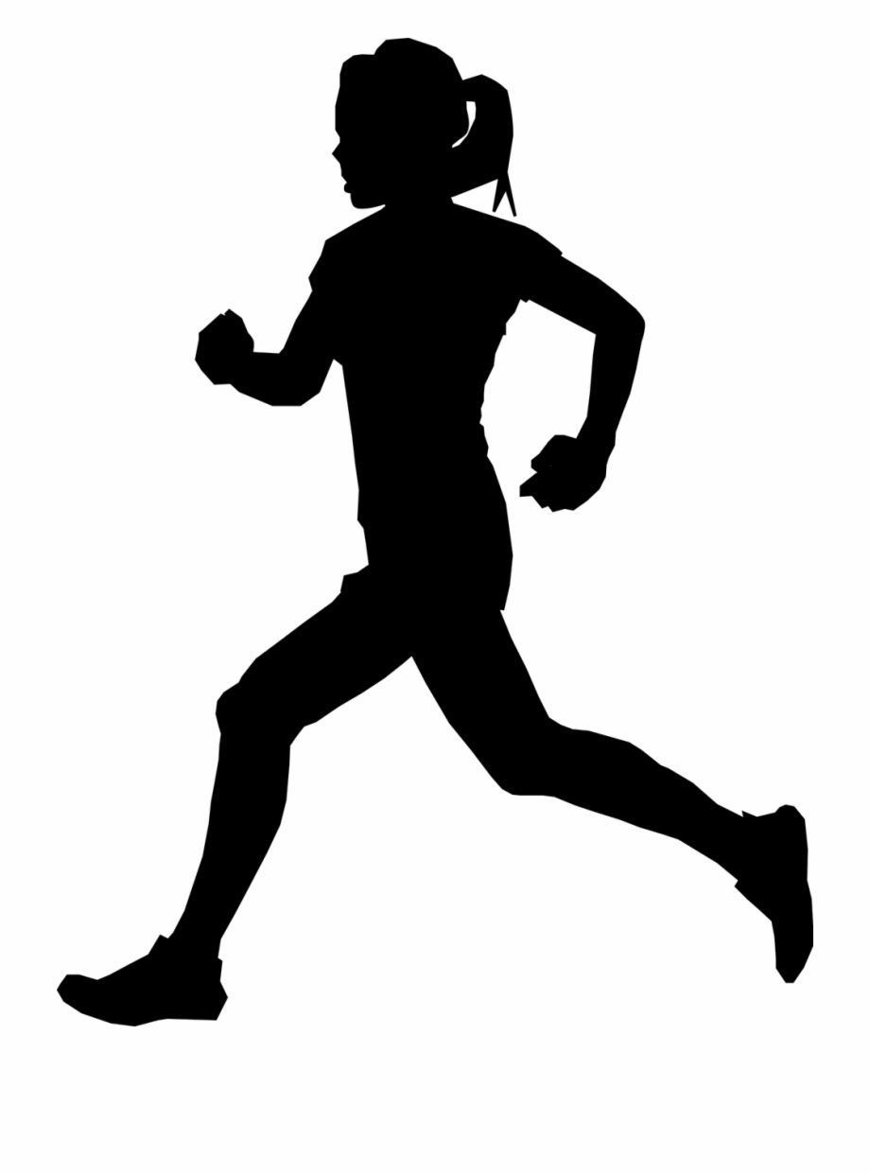
In 2007, Kati Mori took part in the London Marathon – her fourth, and the hottest on record, with temperatures peaking at 75 F. She took frequent drinks at the water stations along the route.
By the 18th mile, Kati felt bad but was determined to finish. By the end, she needed help from other runners to stay upright. Admitted to the hospital, she suffering from severe diarrhea, headache, vomiting and confusion, with her legs endlessly mimicking a running motion. “I thought I was still in the marathon,” she said.
Essential Question: What happened to Kati Mori at the London Marathon?
Notes:
Science Practice 8: Constructing Explanations; HS-LS1-3 Plan and conduct an investigation to provide evidence that feedback mechanisms maintain homeostasis.

Slide 4
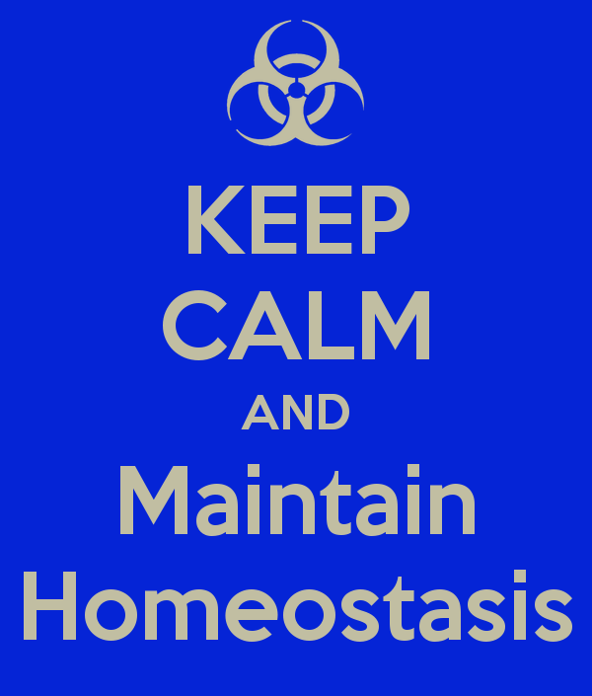
Homeostasis = tendency of the body to maintain a stable, balanced, internal environment. “Sameness”
Energy is required to keep the body in working order. Where does this energy come from?
What clues showed that Kati was not maintaining homeostasis?

Slide 5
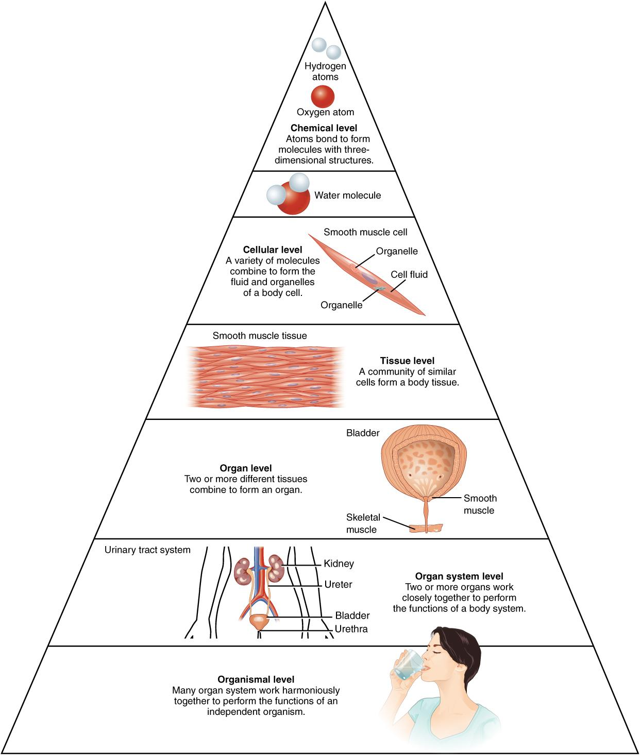
Levels of Organization
Atoms → Molecules → →Cells →Tissues → Organs → Organ Systems → Organism

Slide 6

Functions / Characteristics of Human Life
1. Organization - cells, tissues, organs
2. Metabolism - reactions in the body, requires energy
3. Responsiveness - sense changes and react to them
4. Movement - change in position, motion of internal parts
5. Growth - increase in body size
6. Reproduction - passing DNA to new individuals
7. Development - changes in the body, including differentiation.

Slide 7
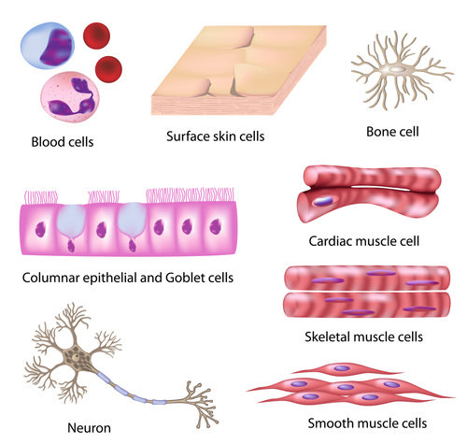
What is differentiation?
- the process by which a cell becomes specialized to perform a specific function
- Cells differentiate by activating and deactivating genes.

Slide 8
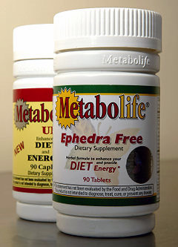
Metabolism = all the chemical changes that occur in the body to maintain life.
Ultimately all of these processes require ENERGY
How do we obtain energy?
Do you think Kati’s problem might be related to metabolism? Why or why not?

Slide 9
1.4 Requirements of Human Life
Oxygen - required to make ATP, cell energy
Nutrients - water, food and vitamins
Temperature - narrow range, body can respond to changes in temperature
Atmospheric Pressure - pressure necessary for breathing
*Read “Why We Need Air Pressure”
How are these life requirements obtained by Kati during the marathon?

Slide 10
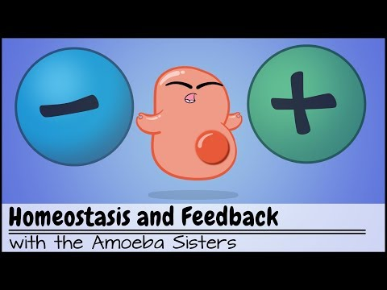
1.5 Homeostasis and Feedback Loops
- how the body makes adjustments when the environment changes and maintains homeostasis
- normal range indicates where the body can function, or what is optimal
- the set point is the value around which the range fluctuates
https://youtu.be/Iz0Q9nTZCw4
~ 6 min

Slide 11
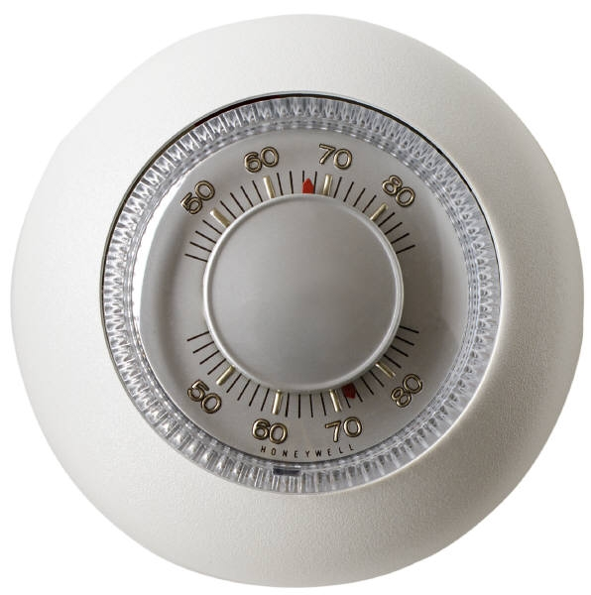
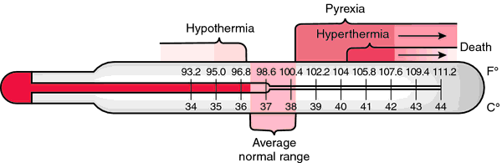
How does a negative feedback loop maintain homeostasis?
Sensors (receptors) detect conditions within the body such as temperature, information is relayed to the brain
Set point – the normal range that an environmental parameter is to be controlled
Effectors – muscles or glands that respond to deviation from the set point. Glands might initiate sweating to cool the body back to its set point.

Slide 12
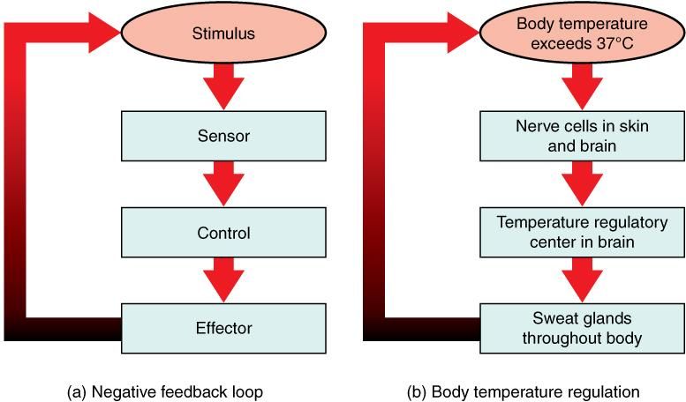

Slide 13
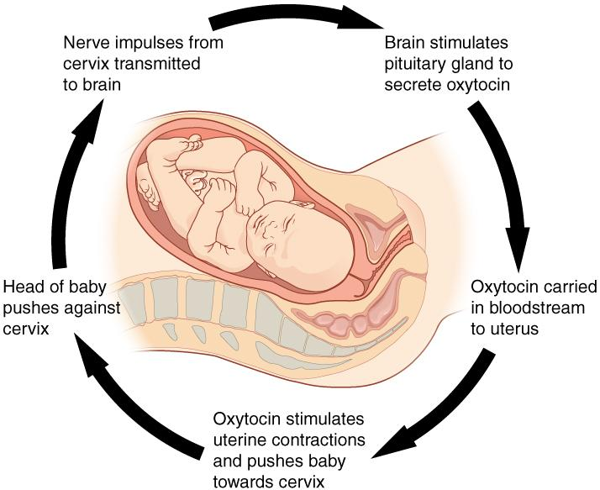
Positive feedback loops
Positive feedback loops amplify or increase the occurrence of events.
As the baby suckles on the nipple there is a nerve response into the spinal cord and up to the brain, which then stimulates the pituitary gland to produce more prolactin to produce more milk
Homework: Feedback Loops

Slide 14
When Kati arrived at the hospital, doctors immediately began to take data on her vitals.
Vital Signs | Normal | Kati
Respiration | 12-20 bpm | 12
Heart Rate | 60-100 bpm | 75
Pulse Oxygen | 95-100% | 98%
Urine Sodium Levels | 135-145 mEq/L | 95
Which vital sign provides a clue to Kati’s problem?

Slide 15
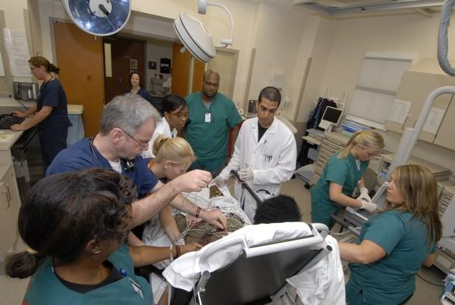
When Kati arrived at the hospital and doctors began to collect information, they discovered that she weighed 128 lbs. Oddly, when she checked in to the race, she weighed 126 lbs.
The doctor suggests that Kati might have “hyponatremia.”
What do you think that is?

Slide 16
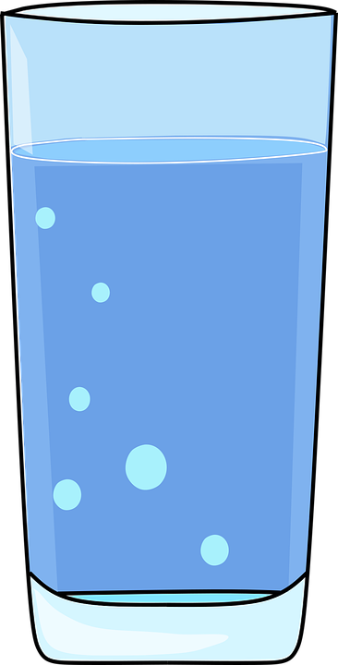
In cases of water intoxication, it is extreme hyponatremia that can ultimately cause coma and death.
The doctor orders a drug that increases urination. Kati is able to clear the extra water from her body and recovers.
How does Kati’s story relate to HOMEOSTASIS?
Myths about drinking water.
1) Drinking 8 glasses a day is a must for everyone.
2) Drinking a glass of water before taking a bath helps lower blood pressure.
3) Being well hydrated will keep my face from getting wrinkles.
4) Drinky icy cold water will help with weight loss.
5) Drinking a glass of water before bed prevents heart attacks.
Source: University of Washington

Slide 17
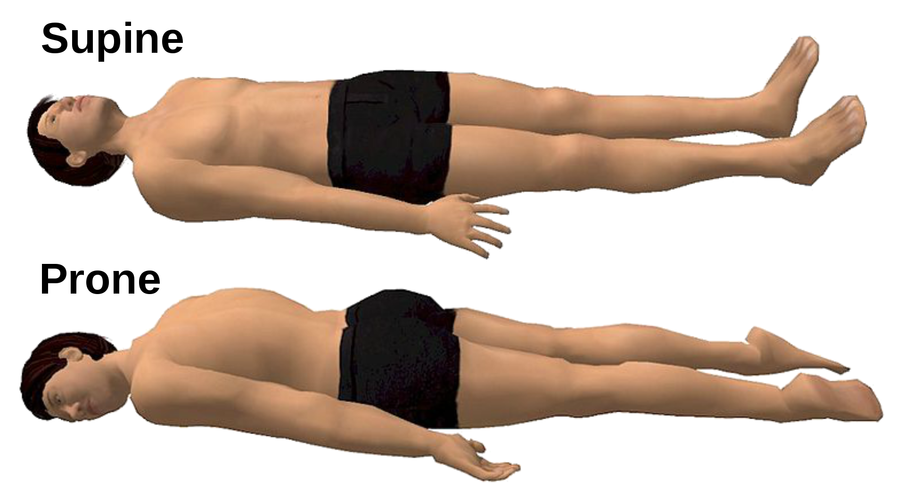
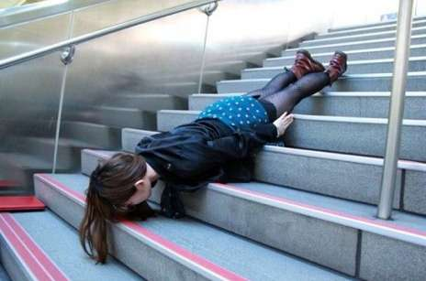
1.6 Anatomical Terminology
Anatomical Position - standing upright, palms facing forward
Prone = face-down Supine = face-up
Planking

Slide 18
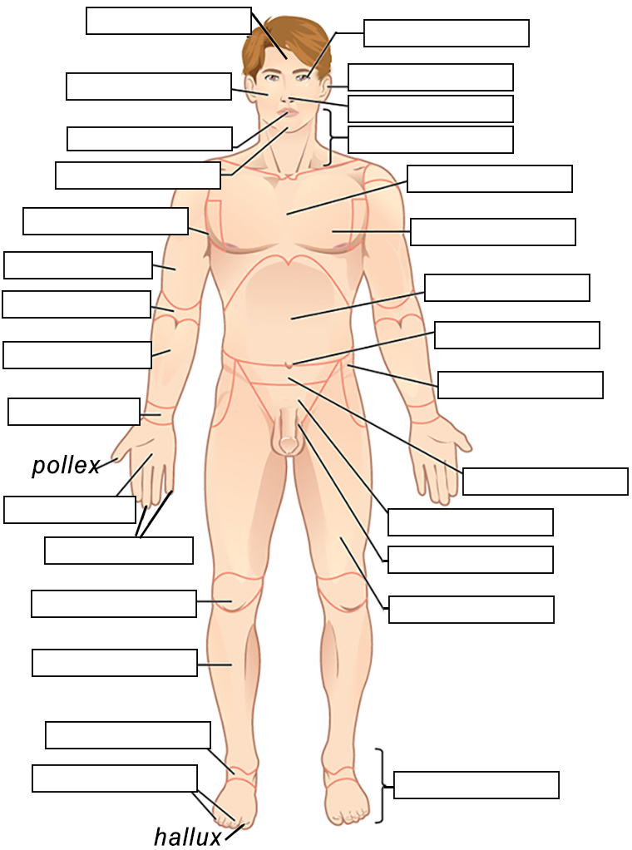
Regional Terms - each area of the body has a name, which is used to label structures nearby
Example: Brachial region = the upper arm
The brachial artery is found in the center of the arm
Label the body regions using the descriptions provided.
Student Handout: https://www.biologycorner.com/anatomy/intro/bodyregions_label.html

Slide 19
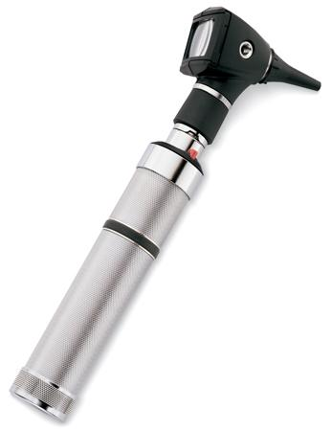
How to Learn the Body Regions
Try to associate the words with something you already know.
Brachial
Cervical
Femoral
Orbital
Pedal
Pectoral
Cephalic
This is an OTOSCOPE

Slide 20
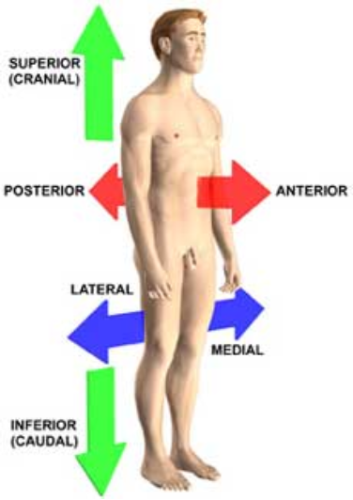
Anatomical Terminology
Anatomical Position = standing erect, face forward, arms at side, palms facing forward
Superior / Inferior
Medial / Lateral
Proximal / Distal
Dorsal / Ventral
Anterior/ Posterior
Sagittal | Transverse | Frontal (coronal)
Superficial / Deep

Slide 21
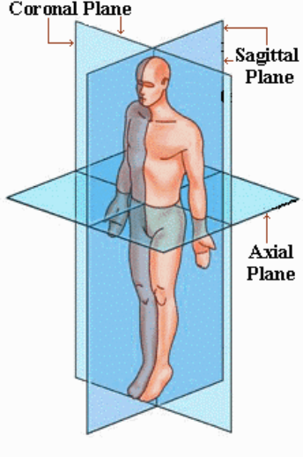
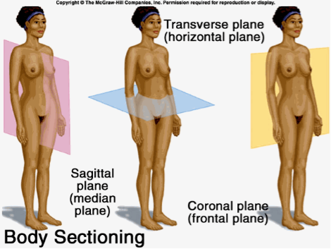
Planes of the Body

Slide 22
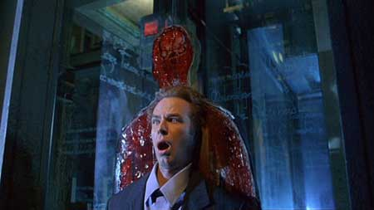
A really sharp pane of glass fell on this unfortunate character.
From the movie “Thirteen Ghosts”
- What kind of cut is this?

Slide 23
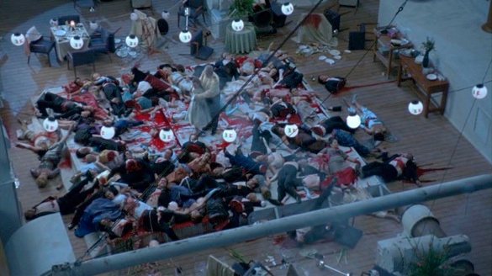
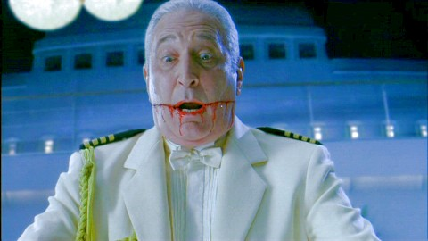
Unfortunate passengers on “Ghost Ship.”

Slide 24
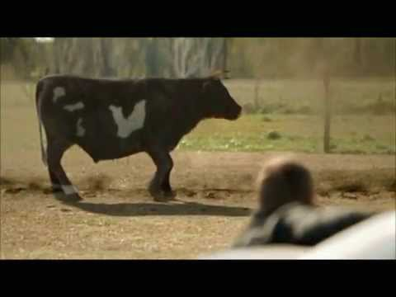
Unfortunate cow. What kind of cut is this?
Activity: Gummy Bear Dissection

Slide 25
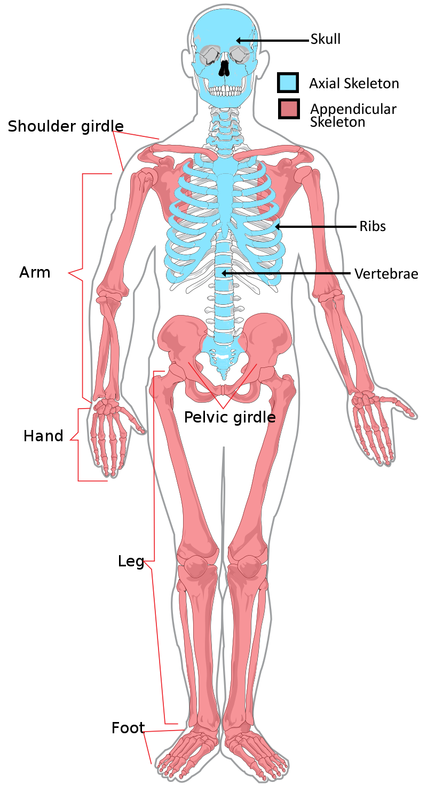
General Organization of the Body
Axial Portion - head, neck, spine
Appendicular Portion
- arms & legs
VISCERA = internal organs.
"Visceral organs"
Notes:
Image Source: https://commons.wikimedia.org/wiki/File:Appendicular_skeleton_diagram.svg

Slide 26
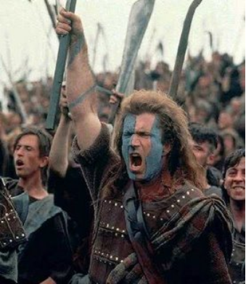
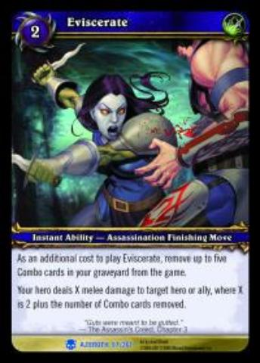
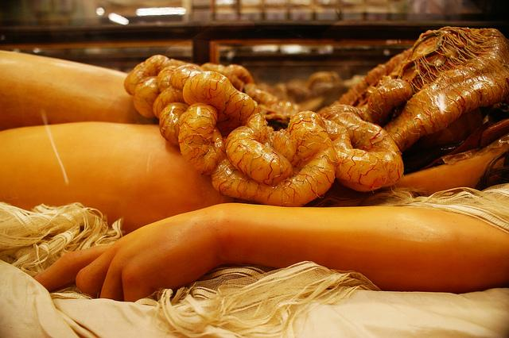
EVISCERATE
Popular in horror movies and games
Photo Source: https://www.flickr.com/photos/pietroizzo/7478162336/in/photostream/

Slide 27
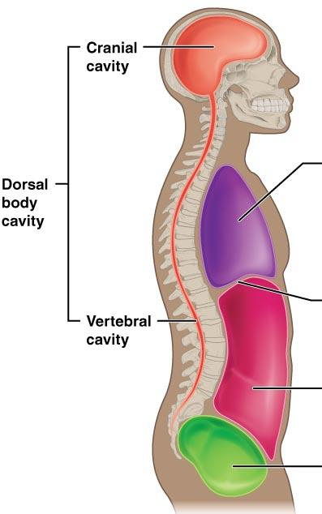
Body Cavities & Membranes
Dorsal Cavity = back side
Ventral Cavity = front side
Cranial Cavity = brain
Spinal Cavity = spinal cord

Slide 28
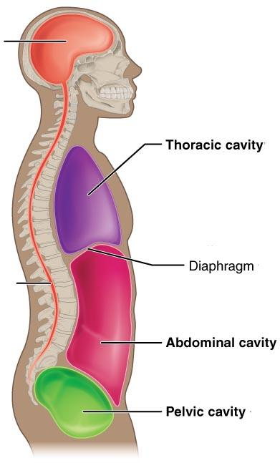
Abdomen = stomach area
(spleen, intestines)
Pelvic = lower abdomen
(bladder, reproductive organs)
Abdominopelvic = abdomen + pelvic
DIAPHRAGM: Separates the thoracic and pelvic region

Slide 29
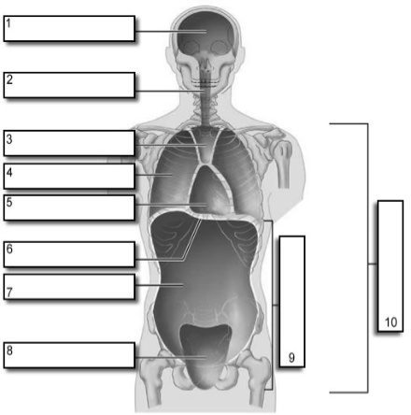
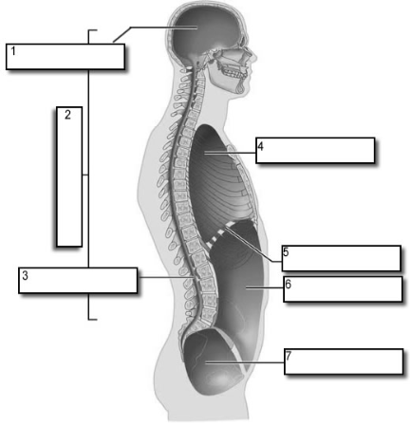
It's easier to visualize the body cavities on pictures
Go to your handout on body cavities. https://www.biologycorner.com/anatomy/intro/body_cavities_label.html

Slide 30
Cranial cavity
Pericardial cavity
Mediastinum
Abdominal cavity
Pelvic cavity
Vertebral canal
Ventral cavity (front)
diaphragm
Abdominopelvic cavity
Pleural cavity (right)
Thoracic cavity

Slide 31
Pelvic Cavity
Abdominal Cavity
Thoracic Cavity
Diaphragm
Vertebral Canal
Dorsal Cavity
Cranial Cavity

Slide 32
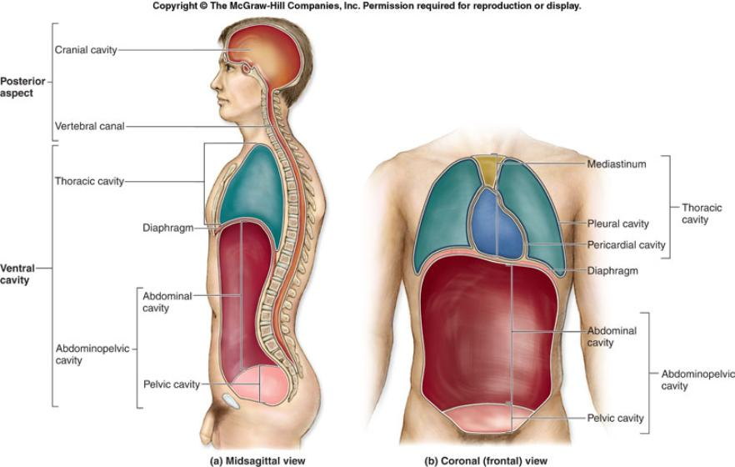
Your tests will contain images for you to label and they may not look exactly the same as the ones you saw in class. Don’t just memorize a picture, understand how the structures are organized.

Slide 33
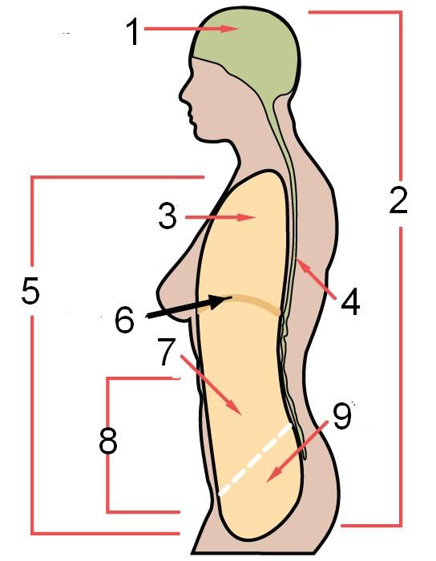
Test Yourself!
One of the most effective ways to study is to frequently self-test.

Slide 34
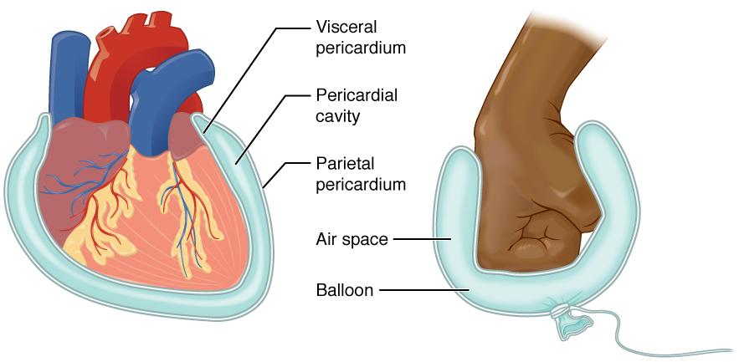
MEMBRANES
Serous Membrane
- two layers, covers organs
Outer layer = parietal
Inner layer = visceral (lines the organs)
Serous fluid – lubricating fluid

Slide 35
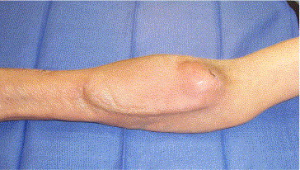
A seroma is a pocket of clear serous fluid that sometimes develops in the body after surgery. This fluid has seeped out of ruptured small blood vessels and fluid produced by the injured and dying cells.

Slide 36
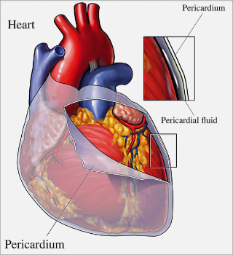
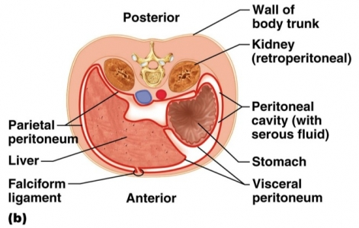
Other Membranes
Pleura = lungs
Pericardium = heart
Peritoneum = organs (abdominopelvic region)

Slide 37
Visceral and Parietal always mean the same thing.
Visceral points toward the guts
Parietal points toward the outside
Visceral Pleura
Parietal Pleura
Visceral Pericardium
Parietal Pericardium
Visceral Peritoneum
Parietal Peritoneum
LUNGS
HEART
INTESTINES

Slide 38
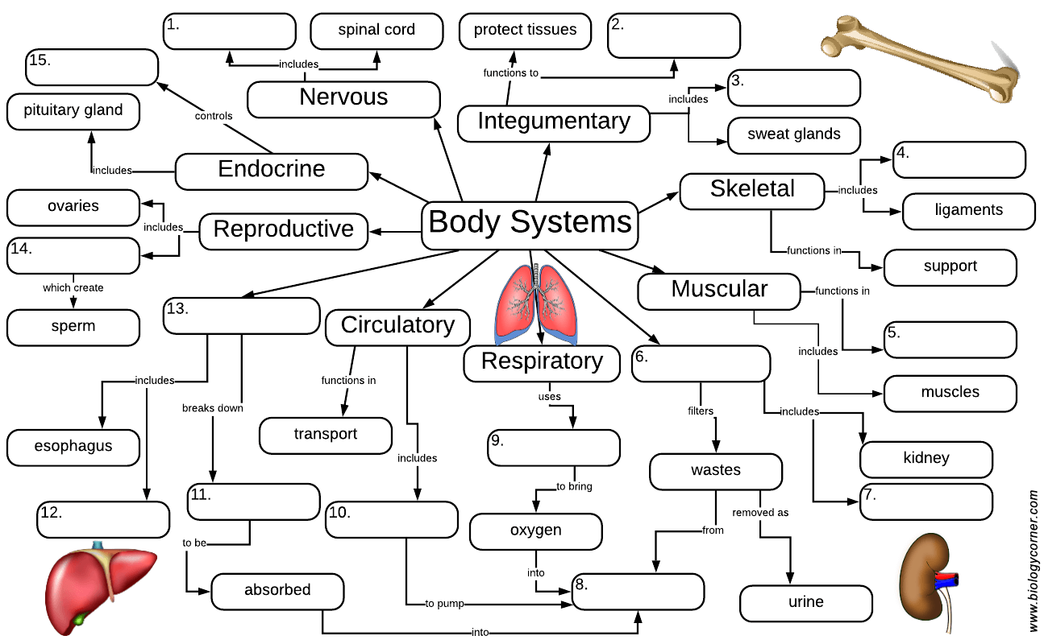
Organ Systems
1. Integumentary
2. Skeletal
3. Muscular
4. Nervous
5. Endocrine
6. Digestive
7. Circulatory
8. Lymphatic
9. Urinary
10. Reproductive
11. Respiratory
-How does each help maintain homeostasis?
-Which systems were involved in Katie’s problem?
Assignment: Organ Systems Concept Map
Homework: Graphic Organizer
https://www.biologycorner.com/anatomy/intro/organ_systems.html

